Slide 1
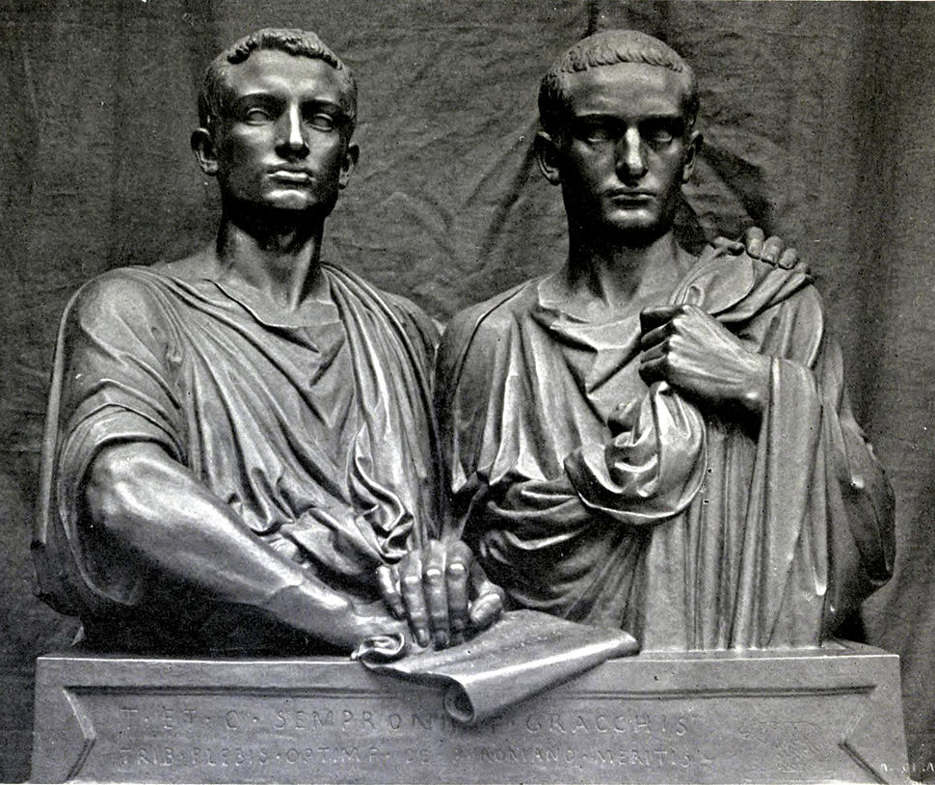
REVIEW
GOAL/S: Review essay writing techniques
Compare and Contrast the Gracchi brothers
Week 4, Lesson 1

Slide 2
Today’s Lesson
Review effective essay writing/structures
Analyse examples – strengths/weaknesses
Group Activity – writing an essay

Slide 3
DISCUSSION – What makes a GOOD essay?

Slide 4
Elements of an essay
Introduction | Body Paragraph | Conclusion
OPTIONAL:

Slide 5
Sample – Thesis Statements
Compare and Contrast the objectives, methods, and impacts of the Gracchi brothers
"This essay will discuss the similarities and differences between the Gracchi brothers in terms of their objectives, methods, and impacts on the Late Roman Republic.”
"Tiberius and Gaius Gracchus were brothers who had both similar and different goals, methods, and impacts on Rome, and this essay will explore those aspects.”
"The Gracchi brothers played roles in Roman politics with various objectives and methods, impacting society differently; this essay will analyze these aspects to understand their contributions to the Late Republic."

Slide 6
Sample – Thesis Statements
Compare and Contrast the objectives, methods, and impacts of the Gracchi brothers
"Although Tiberius and Gaius Gracchus shared a commitment to social reform in the Late Roman Republic, their distinct objectives—Tiberius focusing on agrarian issues and Gaius expanding reforms to citizenship—resulted in varied methods and lasting impacts, ultimately shaping the trajectory of Roman history.”
"While both Gracchi brothers sought to address societal challenges, Tiberius Gracchus concentrated on economic inequality through land redistribution, contrasting with Gaius Gracchus, who broadened the scope by extending Roman citizenship, reflecting a nuanced evolution of populist ideals in Late Republican Rome.”
"In the Late Roman Republic, the Gracchi brothers, Tiberius and Gaius, navigated similar objectives of social reform, but their differing methods—Tiberius' focus on land distribution and Gaius' incorporation of citizenship extension—led to contrasting impacts, illustrating the complex interplay between populist initiatives and Senate opposition."

Slide 7
Questions
What do we need further clarification on?

Slide 8
ACTIVITY – Group Essay Writing
Get
Get into groups of 3 or 4 students (NO MORE THAN 4)
Take out
Take out any information sheets, book work etc about the Gracchi Brothers
Send
Send ONE student up to get today’s worksheet
Sit
Sit quietly and wait for next instruction

